Slide 1
Critical Literacy, Close Reading, and Deep Comprehension: Constructing Meaning in the 21st Century
Maureen McLaughlin
East Stroudsburg University of PA

Slide 2
Goal: Deep Comprehension
How can we teach our students to comprehend at deeper levels?

Slide 3
Integrated Model of Language Arts
Reading
Writing
Speaking
Listening
Viewing

Slide 4
Both the Common Core State Standards and our teaching are based on an integrated model of language arts:
Reading
Writing
Speaking
Listening
Viewing

Slide 5
Question the Author… Question the Context… Question the Text…
Critical literacy views readers as active participants in the reading process and invites them to move beyond passively accepting the text’s message to question, examine, or dispute the power relations that exist between readers and authors—to ponder what the author wants readers to believe, take action, and promote fairness between people. It focuses on issues of power and promotes reflection, action, and transformation (Freire, 1970).

Slide 6
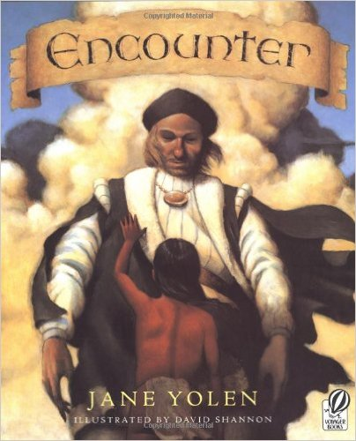
Christopher Columbus… sailed the ocean blue in 1492. Jane Yolen… Encounter

Slide 7
Read from a Critical Perspective
Who is in the text/picture/situation? Who is missing?
Whose voices are represented? Whose voices are marginalized or discounted?
What are the intentions of the author? What does the author want the reader to think?
What would an alternative text/picture/situation say?
How can the reader use this information to promote equity?

Slide 8
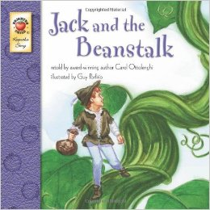
Jack and the Beanstalk (in second grade)
Reading One:
Jack is a nice boy who is good to his mother.
Reading Two: ???
Reading ???

Slide 9
Six Thinking Hats DeBono, 1985
Promotes critical and creative thinking through discussion. The thinking hats represent six different ways of viewing a topic.
The white hat views the information from the objective point of view; the red hat from an emotional perspective; the black hat from a critical point of view; yellow from a positive point of view; green from a creative perspective; and blue from the perspective of monitoring and summarizing what the other hats have done.
According to DeBono, putting on a particular color hat focuses the students’ thinking and switching hats allows them to view the situation from alternative perspectives.

Slide 10
Close Reading of text involves a teacher-guided investigation of a short piece of text, with multiple readings done over multiple instructional lessons.

Slide 11
In the context of a comprehensive literacy framework, Close Reading is an instructional strategy that provides modeling and guided practice of the skills and strategies needed to independently read increasingly complex text and apply newly acquired knowledge in text-based demonstrations of deep understanding.
Brown & Kappes (The Aspen Institute), 2012, p. 4
www.aspeninstitute.org

Slide 12
Through text-based questions and discussions, teachers guide students to deeply analyze and appreciate various aspects of the text, such as key vocabulary and how its meaning is shaped by context; attention to form, tone, imagery and/or rhetorical devices; the significance of word choice and syntax; and the discovery of different levels of meaning as passages are read multiple times.

Slide 13
Mark Up and Annotate Text
Students can:
Use the “Sticky Note” feature in PDFs
Write directly on the passages
Use Mobile apps that can be purchased:
Notability (www.gingerlabs.com/cont/notability.php)
GoodReader (itunes.apple.com/us/app/goodreader-for- ipad/id363448914?mt=8)
iAnnotate PDF (www.branchfire.com/iannotate)
These apps have many more options for students to annotate, highlight, draw, place sticky notes, etc.

Slide 14
The teacher’s goal in the use of Close Reading is to gradually release responsibility to students—moving from an environment in which the teacher models for students the strategies to one where students employ the strategies on their own when they read independently.
The Aspen Institute, Brown & Kappes, 2012, p. 2

Slide 15
Analyze
To examine the structure of information in detail, particularly for the purpose of explanation
To demonstrate an ability to see patterns and classify information into component parts

Slide 16
When analyzing text…
Generate and Respond to Questions … Discuss
Use Knowledge of Text Structures … Discuss
(Narrative, Informational)
Investigate Vocabulary …Discuss
Question the Author…Question the Context…Question the Text … Discuss
Mark-up, Annotate Text … Discuss
Summarize Text … Discuss

Slide 17
Generate and Respond to Questions

Slide 18
Question Types
Memory Questions:
SIGNAL WORDS: Who, what, where, when?
COGNITIVE OPERATIONS: Naming, defining, identifying, designating
Convergent Thinking Questions:
SIGNAL WORDS: Why, how, in what ways?
COGNITIVE OPERATIONS: Explaining , stating relationships, comparing and contrasting
Divergent Thinking Questions:
SIGNAL WORDS: Imagine, suppose, predict, if/then
COGNITIVE OPERATIONS: Predicting, hypothesizing, inferring, reconstructing
Evaluative Thinking Questions:
SIGNAL WORDS: Defend, judge, justify/ What do you think?
COGNITIVE OPERATIONS: Valuing, judging, defending, justifying Ciardiello, 1998, 2007

Slide 19
Thick and Thin Questions
Page:
Thin Questions
Thick Questions

Slide 20
Use Knowledge of Text Structures: Narrative
Characters
Setting
Problem
Attempts to Resolve
Resolution

Slide 21
Use Knowledge of Text Structures: Informational
Problem/Solution Cause/Effect Comparison/Contrast
Definition Chronology/Series of Events

Slide 22
Investigate Vocabulary
Importance of context clues

Slide 23
Context Clues
Definition
Root Words and Affixes
Example-Illustration
Grammar
Compare-Contrast
Logic
Cause and Effect
Mood and Tone

Slide 24
Cueing Systems
Graphophonic
Syntactic
Semantic

Slide 25
Summarize Text – Narrative
Retell in a variety of modes
Create Lyric Retellings

Slide 26
Summarize Text – Informational
Scaffold Summarizing of Informational Text:
Concept of Definition Map
Questions into Paragraphs
Lyric Summaries, Bio-Pyramid, Definition Poems

Slide 27
Concept of Definition Map Schwartz & Raphael, 1985
How would you
describe it?
What is it?
A comparison
Focus Word:
What are some examples?

Slide 28
QuIP Research Grid (E.M. McLaughlin, 1987)
Topic: __________________________
Questions
Answers
Source 1:
Source 2:
A.
B.
C.

Slide 29
Multimodal Text

Slide 30
Examples of Multimodal Text Across Grade Levels
The Very Hungry Caterpillar- DVD
Brown Bear and Friends - CD
The Magic School Bus - DVDs
“Stopping by Woods on A Snowy Evening”- Poetry Speaks - spoken word
Hamlet – film; Hamlet- graphic novel; Hamlet- BBC Radio

Slide 31
Multiple Representations of Thinking
Transmediations
Electronic Alphabet Books
Digital Recordings

Slide 32
Conclusion
We have learned, as P. David Pearson (2001) has noted, that “comprehension is never enough; it must have a critical edge.” Comprehending with a critical edge means moving beyond understanding the text to understanding the power relationship that exists between the reader and the author—to knowing that even though the author has the power to create and present the message, readers have the power and the right to be text critics – to read, question, and analyze the author’s message.
We need to refocus. We need to actively engage—to become participants in this power relationship—to find new ways of seeing beyond the text, inside the text, and around the text. We need to become text critics. We need to move beyond passively accepting information and analyze it from a critical perspective.

