Slide 1
it’s HOT, HOT, HOT!
Young Adult
Lisa Osur, Holley MSHS Librarian

Slide 2
Defining YA
DEFINE the reader
a young adult is defined by publishers as ages 12-17
DEFINE the work
a kind of innocence- it's the loss of that innocence that makes a young adult character so different and a YA novel so poignant
fidelity to its intended audience is paramount- the reader has to be able to put him or herself in the character’s shoes
the conflicts the characters go through are relevant to teens
protagonist as well as the majority of the key characters are teens
unique viewpoints in the stories, illuminated with emotion, but not informed by experience

Slide 3
A few facts
HARRY POTTER led the way-
55% of YA books are bought by adults and 78% of them purchase for themselves (www.publishersweekly.com )
Average number of minutes spent reading is rising despite fears of media saturation (http://kff.org )
young adults are the most literate demographic (www.unesco.org/ )
3,000 young adult novels were published in 1997. Twelve years later, that figure hit 30,000 titles- with total sales in 2009 exceeding $3 billion (http://www.mcsweeneys.net/ )
Childrens’ book publishing is the fastest growing segment of the publishing market with YA leading the way. From 2010-2012 there was a 24% increase in childrens’ book sales! (www.nielsen.com/ )
Few readers have abandoned print for ebooks- they’ve simply added it as another format. 2013 (www.pewinternet.org )
Notes:
In 2004, the National Endowment for the Arts (NEA) published a study titled Reading at Risk: A Survey of Literary Reading in America, reporting that the number of literature-reading young adults dropped 20 percent between 1982 and 2002—the greatest recorded loss of readership in the country’s history. The decline represented 20 million potential readers and Dana Gioia, NEA Chairman, called it a “national crisis.”
A recent survey issued by Scholastic, the 2010 Kids & Family Reading Report, found that 43 percent of the children ages 9-11 believe the most important outcome of reading books for fun is to open up the imagination. 62 percent of the same demographic say they read books for fun “to be inspired by storylines and characters.” For a group whose numbers were clearly dwindling in the 1990s, it is not surprising that the release of an incredibly imaginative story coincided with a dramatic revival or readership.
Harry Potter entered the pop-culture consciousness. The movies… heightened the fervor, spawning video games and collectible figurines. That made it easier for kids who thought reading was for geeks to pick up a book.”
Booklist magazine critic Michael Cart writes, “Kids are buying books in quantities we’ve never seen before… And publishers are courting young adults in ways we haven’t seen since the 1940s… We are right smack-dab in the new golden age of young adult literature.”
In January 2010, the Kaiser Family Foundation published a comprehensive study of the media habits of more than 2,000 eight to eighteen year-old American children. The study found that the average time spent reading books for pleasure in a typical day rose from 21 minutes in 1999 to 23 minutes in 2004, and finally to 25 minutes in 2010. The rise of screen-based media has not melted children’s brains, despite ardent warnings otherwise: “It does not appear that time spent using screen media (TV, video games and computers) displaces time spent with print media,” the report stated. Teens are not only reading more books, they’re involved in communities of like-minded book lovers.
Half of the 9-11 year-olds surveyed by Scholastic said they read books to “help you figure out who you are and who you could become.” What began with Harry Potter, an undoubtedly captivating and even inspiring work, is now commonplace.
what we’re currently witnessing appears to be the genre’s true renaissance. It’s a time when these books are not only accepted by our culture, but actually embraced and celebrated. These days, reading (fanatical reading at that) is a part of young adulthood and there’s no reason to believe that digital age precludes that “touch of Harry in the night.”
http://www.mcsweeneys.net/articles/young-people-are-reading-more-than-you BY HANNAH WITHERS AND LAUREN ROSS
A deeper dive by Nielsen into what teens like to read puts adventure at the top of the list with 48% of teen readers interested in that genre. Fantasy and science fiction ran two-three in popularity. Books made into movies was another popular category and the importance of movies to teen book-buying habits cannot be overstated. Teens reported that among the most important factors that made them aware of particular titles involved either seeing a movie based on a book or having seen a book trailer at a movie theater.
http://www.publishersweekly.com/pw/by-topic/childrens/childrens-industry-news/article/61167-children-s-books-a-shifting-market.html
Reading is on the Rise: a new chapter in American literacy study- National Endowment for the Arts 2008
Literary reading has increased most rapidly among the youngest adults. (granted young adult here is referring to 18-24
http://arts.gov/sites/default/files/ReadingonRise.pdf

Slide 4
A few more facts- FYI
Harry Potter- sold over 400 million copies
50 million copies of The Hunger Games books sold
Wonder by RJ Palacio sold 1 million copies in 18 months and spent 53 weeks on the bestsellers’ list
Diary of a Wimpy Kid sold 115 million copies
The Fault in Our Stars- 1 book! Sold almost 11 million copies since it’s publication less than 2 years ago
Adult author are joining the bandwagon- James Patterson, David Baldacci, Jodi Picoult, Harlan Coban, Neil Gaiman, Kathy Reichs, Phillipa Gregory, John Grisham to name a few

Slide 5
What I love about YA
YA explores diversity- YA pushes the envelope
YA lets kids ‘experiment’ and discover safely
Number of messages in YA- educating teens
YA offers the opportunity to inspire teens to improve our world
YA gives teens an introduction to global cultures
YA provides escapism- growing up is hard enough sometimes
YA builds readers- no one is non-reader… they just haven’t been given the ’right’ book yet and there are SO many ‘right’ YA books ☺
Notes:
Graphic novel to novel

Slide 6
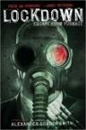
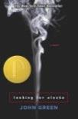
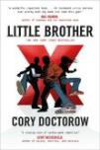
Most popular titles- 2014

Slide 7
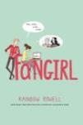
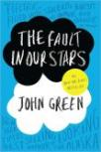
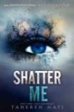
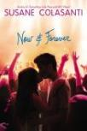
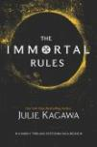
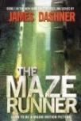
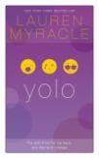
NEWEST popular titles
The Maze Runner and If I Stay are not new, but newly popular due to movie releases.
Notes:
Fangirl- the mother died, and for Cath, being a Simon Snow fan is her life- reading and writing fan fiction, but twin sister Wren has ‘grown up’. Can she do it on her own?
We Were Liars- priviledged Cadence Sinclair Eastman suffers a head injury on the island during her 15th summer. Two years later she’s there with the other ‘liars’- her cousins and aunt’s nephew- trying to put the pieces together- what happened?
Slated by Teri Terry- Kyla has been ‘slated’ which means her memory and personality have been erased and she’s had to start over- new family, new identity- and now THEY’re watching her. What did she do?
Shatter Me by Tahererh Mafi- Juliette has been imprissoned because she is cursed with the power to kill with a touch. This is a romance-laced dystopian story.
Splintered by A G Howard uses Lewis Carol’s Alice in Wonderland as a backdrop (Looking Glass Wars by Frank Beddor) also weaving in the story of the ‘real’ or ‘original’ Alice. Alyssa is a descendent of Alice Liddell and is plagued by madness- she hears insect noises. “A cavalcade of wierdness dances across the pages” as she and Jeb traverse a nightmare Wonderland (horror).
Panic by Lauren Oliver- Panic is a legendary small-town game played by graduating seniors- a game of fear (desperate energy to get out- resonates with teens)
Now and Forever- Susane Colasanti- superficial romance, but the girls love them- in this one, Sterling’s boyfrind becomes an overnight music sensation and she gets swept up too, later realizing that she is giving up her SELF (sound familiar?)
The Darkest Minds by Alexandra Bracken- Ruby was 10 when the virus struck killing 98% of teens. The survivors developed psychic abilities and have been locked up in brutal work camps where they are split into 5 categories ranging from lease to most dangerous (sounds like Divergent with it’s factions). In this dystopian near future, children are hunted and feared, and danger lurks everywhere- even in the aisles of an abandoned Walmart.
The Immortal Rules by Julie Kagawa- In this ruined world, vampires keep humans as blood cattle. With most of civilization killed off by disease, can they find a cure
YOLO by Lauren Myracle- the beloved ‘Internet Gilrs’ (TTYL, TTFN, L8r,G2r) are now freshmen in college (reminicent of The Traveling Pants)- funny

Slide 8
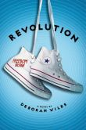
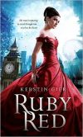
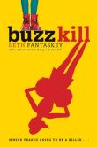
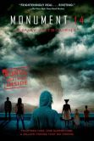
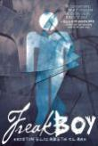
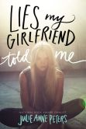
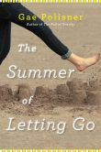
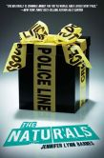
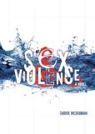
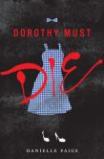
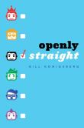
NEW titles
Notes:
I expect will be popular once discovered.
Revolution is #2 in the Sixties Trilogy which started with Countdown. This one is about civil rights and Freedom Summer.
Ruby Red is book 1 of a 3-part series which is new to us- described as humorous, romantic and suspenseful. It is followed by Sapphire Blue and Emerald Green- by Kerstin Gier.
The summer of Letting Go is a coming of age and acceptance story- Frankie’s brother died in a drowning accident 4 years ago, and her new charge is 4 years old- coincidence or connection?
Buzz Kill is Beth Fantaskey’s (Jessica’s Guide to Dating on the Dark Side) newest book- mystery & humor- fast-paced blend of Clueless and Nancy Drew a who done it
Sex & Violence by Carrie Mesrobian is selling itself with its title and has already been checked out- no word yet on its merit, but it’s the story of Evan who finds hooking up with the wrong girl very dangerous and must clear his name.
Dorothy Must Die by Danielle Paige has already been checked out (the student LOVED it and is already highly anticipating it’s sequel- The Wicked Will Rise due out in March 2015)- a reluctant hero swept up in a tornado finds herself in a very different Land of OZ- she’s from Kansas and her name is Amy Gumm AND she’s been recruited by the Revolutionary Order of the Wicked- OH MY!
Monument 14 by Emmy Laybourne has been out, but we just got it and it’s sequels Sky on Fire & Savage Drift. A group of kids- high school, middle school and little kids, take refuge in a superstore during a weather and chemical apocalypse. TBF author
The Naturals by Jennifer Barnes (TBF author) The FBI is using Cassie’s unusual gift to crack cold cases- turns out she’s not the only one- a psychological thriller.
Freakboy, Lies my Girlfriend Told Me and Openly Straight are this year’s additions to a robust GLBTQ collection which includes nonfiction and fiction- I put up a display every year at some point to market this collection to my students who use it. Did you know that the majority of teens who read GLBTQ are heterosexual girls? In my mind, they’re the most mature and questioning, willing to explore/discover and accept the differences in others- it’s called curiosity!
Freakboy by Kristen Elizabeth Clark is Brendan- a star wrestler, video game aficionado and good boyfriend, but he doesn’t feel right in his body- is this normal or is he a freak- written in ‘razor-sharp verse’
Lies My Girlfriend Told Me by Julie Anne Peters is the story of Alix, who when her girlfriend dies, discovers that she had led a double life and had another girlfriend, Liana. When Alix arranges to meet Liana and they become close she finds herself hiding the past- who’s the betrayed?
Openly Straight by Bill Konigsberg is a funny story about Rafe, who is openly gay until he moves to a new town and pretends to be straight because he doesn’t want being gay to define him- he’s also a writer, skier, soccer player. A what-it-means-to-be-yourself story.

Slide 9
What do I do with my books?
Memoirs & Biographies
Retold Fairy Tales
Dystopia
Environmental
Architecture
Pre & Post Civil War nonfiction
Bullying
Criminal Justice
Graphic Novel graduation
Playaway audiobooks
Displays
GLBTQ
Books to movies
NEW books
Bullying
Snuggle with a book (winter/snow themes)
Spring- green book covers
Multicultural

Slide 10
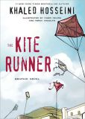
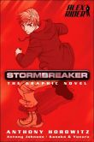
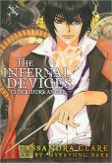
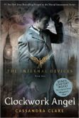
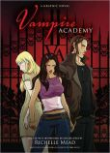
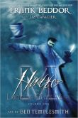
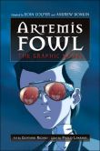
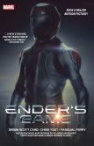
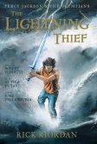
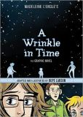
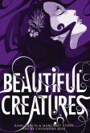
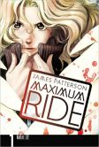
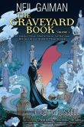
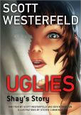
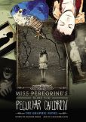
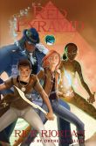
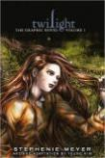
GRAPHIC NOVELS
Notes:
I use my graphic novel adaptations of popular novels to entice my non-readers (or those who think they are non-readers) to graduate from their preferred graphic novel/comic books, being familiar with a story they like, hoping it will be a little easier for them having a previous familiarity with the story.
There are so many great adaptations out now and they continue to come!
I also have my graphic novels collection in a completely separate part of the library, cataloged under GN- biographies, nonfiction and fiction. They are inter-shelved with the manga (and I should probably pull them out as I find those are often different customers. The trick is to get them to go from manga, to graphic novels, to novels- it’s a process ☺

Slide 11
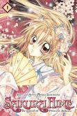
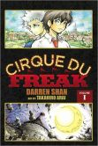
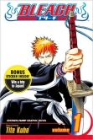
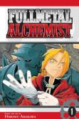
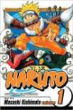
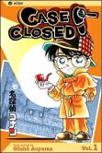
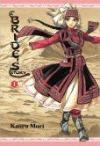
Manga
Notes:
I don’t claim to know much about manga, but I DID start a graphic novels collection in every library job I’ve had- school and public- and have had a graphic novels club in the past. I let the student and my patrons who read manga tell me what they want. They research, price and provide me a wish-list each year, and when I can, I buy new and/or add volumes to the already popular series.
Bleach- Ichigo sees spirits unable to rest in peace, then he becomes the Soul Reaper.
Bride’s Story- Silk Road comes to life in this story of a young nomadic girl betrothed to a boy 8 years her junior.
Cirque du Freak- Darren is an average kid until he discovers Cirque du Freak where he finds vampires, strange creatures, werewolves.
K-ON- Azusa is left to rebuild her pop music group when the other members all graduate- and none of the new recruits have any musical experience.
Case Closed- mystery a la Sherlock Holmes
Fullmetal Alchemist- the world has been ravaged by the abuse of alchemy and everyone is in pursuit of the ultimate alchemical treasure- the Philosopher’s Stone (said to be capable of turning base metals into gold).
Dramacon- set at a comic convention, self-willed Chris comes into her own
The starred ones are those I either added to or purchased new this year.

Slide 12
Middle School authors
Chris Colfer (Land of Stories)
Chris D’Lacey (The Last Dragon)
John Flanagan (Ranger’s Apprentice, Brotherhood Chronicles)
Erin Hunter (Warriors, Seekers, Survivors)
Jeff Kinney (Diary of a Wimpy Kid)
Mike Lupica
Brandon Mull (The Beyonders)
R. J. Palacio (Wonder)
James Patterson (Middle School, Maximum Ride, Daniel X, Witch & Wizard)
Rick Riordan (Lightning Thief, Kane, Heroes of Olympus)
Darren Shan (Cirque du Feak, Zom-B, Demonata, Larten Crepsly)
Michael Scott (Alchemist)

Slide 13
Reluctant boy readers
These are what I hand them-
Peak by Roland Smith
The Outsiders by SE Hinton
Touching Spirit Bear by Ben Mikaelsen
Ender’s Game by Orson Scott Card
Code Talker by Joe Bruchac
You by Charles Benoit
Whale Talk by Chris Crutcher
anything by Carl Deuker, Gary Paulsen (yes… still!), Gordon Korman and James Patterson
NONFICTION in their interest (robots, war, sports, gaming)

Slide 14
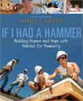
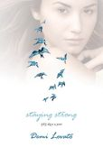
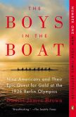
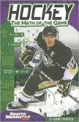
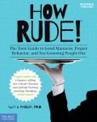
NONFICTION
Notes:
When purchasing nonfiction these days I limit my choices to high-interest subjects and titles that my students will read. Gone are the days when I purchased nonfiction titles mostly related to research- those I purchase electronically through databases or ebooks. That is not to say that my nonfiction is not Common Core aligned and related to class curriculum, they’re just readable and of interest to my students.
You’ll see from this year’s selections that I chose several history-related titles- I happen to work closely with my social studies teachers and have a lot of student who are interested in history, especially wars and the military. I found a great collection of dogs-in-war book an created a mini-collection, I added to my list of novels for the college history students (they have to read a historical nonfiction novel each semester- pre-civil war in the fall, and post-civil war in the spring
I also added to my Captured World History collection (the history behind the photograph) with 6 new titles- Tank Man about Tiananmen Square, Hitler in Paris, The Blue Marble, Summiting Everest from Capstone, and Civil War Witness and Assassination and it’s Aftermath from Compass Point Books. I collaborate with a social studies and art teacher using these books which describe the setting and significance of these important points in history, immortalized in a photograph.
I’m always looking for something new to replace the old- which the students don’t have any interest in, but I know is an important subject. This year I found How Rude- a new take on Miss Manners. I had just weeded some very old etiquette books and thought to never replace them until I saw this!
The Math in Hockey is part of a small series that helps students realize the importance of a subject they may find difficult and can’t see ever using in real life- here’s the real-life connection (Common Core baby!)
And I’m always trying to find books that my students can use to give them ideas of how to plan to be the best person they can be- encouraging them to become contributing members of a democratic society.

Slide 15
BIOGAPHIES
Notes:
I would have included the biographies with the nonfiction, except that I do a BIG biographies and memoirs project with one of my English teachers so I build on my collection whenever I can to provide new and high-interest titles.
This year I went with a theme of ‘If you hear it on the news…’ and added the following titles.
:
A Stolen Like- the Jaycee Dugard story- by Jaycee Dugard
Growing Up Duggar by the Jessa, Jana, Jill and Jinger Duggar (19 Kids and Counting TV show- Christian)
I Am Malala: the girl who stood up for education and was shot by the Taliban by Malala Y0usafzai
Life in Motion: an unlikely ballerina by Misty Copeland (UnderArmour ad- I will what I want)
Monster: the autobiography of an L. A. gang member by Sanyika Shakur Born Kody Scott he became one of the most feared and violent members of the gang Crips and was named the Monster. He wrote his autobiography while in solitary confinement where he underwent a complete personal and political transformation.
No Summit Out of Sight: the true story of the youngest person to climb the seven summits by Jordan Romero. At thirteen he became the youngest person to summit Mt Eerest and at 15 he had accomplished the summits of all the tallest mountains on each the 7 continents.
Amanda Knox: waiting to be heard by Amanda Knox. Accused of killing her roommate, Knoz spent 4 year in an Italian prison before being acquitted- here are her diary and journal entries.
Exposed: the secret life of Jodi Arias by Jane Valez-Mitchell. Jodi Arias was found guilty of killing her boyfriend- a brutal murder- while exposing her past.
Bobby Orr: my story by Bobby Orr. Legendary defenseman for the Boston Bruins and Chicago Blackhawks, Orr tells the story of his childhood in Ontario, Canada and rise through the NHL ranks.
Grace, Gold, and Glory: my leap of faith by Gabrielle Douglas. Gold medal Olmpian Gabi Douglas tells the story of faith, perseverance and determination.

Slide 16
COMING SOON
TBF 2015
May 16th @ NAZ
CNN piece on top 40 new YA- Sept & Oct
Notes:
The Infinite Sea by Rick Yancey- sequel to The 5th Wave (9/16)
Since the alien invation (Ender’s Game), the first, second, third and fourth waves have come- bad things are happening to good people at an amazingly fast rate- a REAL page-turned
GASP by Lisa McMann- Jules has visions and now she’s trying to help those like her before it’s too late.
Afterworlds by Scott Westerfeld (9/23)- a book within a book, this is the story of a young author who moves to NY to write- her novel Afterworlds is a terrorist thriller interwoven with the writer’s story.
The Blood of Olympus by Rick Riordan- Heroes of Olympus #5 (10/7)
The Young Elites by Marie Lu (10/7) New from the author of the Legend series, Adelina survived the blood plague leaving her special powers. These children are called the Young Elites- there’s a faction that want to kill them, and another trying to save them before they’re discovered, but Adelina’s powers are something no one has ever seen before and they have evil in them. (Divergent, Dualed)
Emergent by Cohn (10/7) #2 in the Beta series about clones, Elysia’s First is alive so she has a soul, but Zhara is out to destroy her.
Zom-B Family by Darren Shan- #9 in the series (10/7)
Glory O’Brien’s History of the Future by AS King (10/14) With no plans for her future, Glory suddenly begins seeing the infinite future of others and it’s terrifying. Freedom, feminism and destiny are the message in this story by award winning and TBF regular, King.
Stike by DJ MacHale (10/14) #3 of the SYLO Chronicles trilogy- pulse-pounding suspense, you won’t be able to put it down.
UnDivided by Neal Shusterman- #4 and final in the Unwind series (10/14) TBF author.
In the Afterlight by Alexanra Bracken (10/28) Darkest Minds #3- IANN has killed most of the world’s children, the rest are put in camps and escaping the LA government’s attack leads the group north to regroup and plan to fight back.
In the Afterlight by Alexandra Bracken- #3 in The Darkest Minds series- Ruby is now the leader and allies herself with Cole to free the rest of the kids in camps and to discover the cause of IANN- the disease that killed most of America’s children.
Talon by Julie Kagawa (10/28) TBF author. New from Kagawa (Tiger’s Curse) a modern fantasy story of dragons. Almost all the dragons were killed by dragon slayers, but secretly they have revived and are planning vengance. (Eon, Eldest, Last Dragon Chronicles by D’Lacey, Dragon Rider, Seraphina)
Press Play by Eric Divine (10/28)- new book about a film student who catches a brutal hazing incident on tape.
Mortal Heart by Robin LaFevre (11/4) #3 His Fair Assassins. The last sister is planning to be an assassin when she discovers she’s being trained to be a seeress and will never leave the convent.
The Long Haul by Jeff Kinney- #9 of the Diary of a Wimpy Kid series (11/4) ROADTRIP!
The Sorcerer’s Heir by Cinda Chima (11/4) Heir Chronicles #5- fragile peace, but now suspected of vicious murders, Emma & Jonah must learn to trust each other.
Unbroken (YA adaptation) (11/11) Louie Zamporini
The Bane Chronicles by Cassandra Clare- Mortal Instrument companion (11/11)
Rogue Knight by Brandon Mull- #2 in the Five Kingdom’s series (11/18) Magic and danger abound- fantasy adventure

Slide 17
YA Book to movie
Harry Potter by JK Rowling
City of Ember by Jeanne DuPrau
Sisterhood of the Traveling Pants by Ann Brashares
Perks of Being a Wallflower by Stephen Chbosky
Twilight by Stephanie Meyer
Beastly by Alex Flynn
Hunger Games by Suzanne Collins
The Lightening Thief by Rick Riordan
Nick & Norah’s Infinte Playlist by Rachel Cohn
City of Bones by Cassandra Clare
Beautiful Creatures by Margaret Stohl & Kami Garcia
Vampire Academy by Richelle Mead
The Book Thief by Marcus Zusak
Divergent by Veronica Roth
The Fault in Our Stars by John Green
The Giver by Lois Lowry
Delirium by Lauren Oliver
If I Stay by Gayle Forman
The Maze Runner by James Dashner
And coming soon to a theatre near YOU:
Delirium by Lauren Oliver (Hulu)
Fallen by Lauren Kate (2015)
Revenge of the Witch: The Last Apprentice by Joseph Delaney (2015)
Paper Towns by John Green (2015)
The 5th Wave by Rick Yancey (2016)
Miss Perigrine’s Home for Peculiar Children by Ransom Riggs (2016)
Magyk: Septimus Heap by Angie Sage (2017)
http://www.bigbookstinyvoices.com/2013/03/16/60-upcoming-young-adult-book-to-movie-adaptations/
Notes:
In development:
The Alchemist: the secrets of the immortal Nicholas Flamel by Michael Scott
Daughter of Smoke & Bone by Laini Taylor
Eleanor & Park by Ranibow Rowell
The Graveyard Book by Neal Gaiman
The Wolves of Mercy Falls, Raven Boys and Scorpio Races by Maggie Stiefvater
Artemis Fowl (books 1&2) by Eoin Colfer
Anna Dressed in Blood by Kendare Blake
Shadow & Bone by Leigh Bardugo
Shatter Me by Tarereh Mafi
Wake by Lisa McMann (Milye Cyrus)
Uglies by Scott Westerfeld
Wings by Aprilynn Pike
Under the Never Sky by Veronica Rossi
Switched: the Trylle trilogy by Amanda Hocking
Tiger’s Curse by Colleen Houck
Peter and the Starcatchers by Dave
Matched by Ally Condie
House of Night by PC Cast
The Lost Book of Merlin by TA Barron
The Looking Glass Wars by Frank Beddor
Legend by Marie Lu
The Knife of Never Letting Go by Patrick Ness
The Iron Trials by Cassandra Clare & Holly Black
Incarceron by Catherine Fisher (Taylor Lautner)
Forest of Hands and Teeth by Carrie Ryan
http://www.youtube.com/watch?v=AwwbhhjQ9Xk

Slide 18
YA genres
NEW
Contemporary
Realistic
Christian
Edgy
Historical
Steampunk
Science fiction
Dystopian
Apocalyptic
Steampunk/Cyberpunk
NEW cont…
Paranormal
Vampires
Zombies
Angels
LGTBQ
Mystery Thriller
Urban Fantasy
Graphic novel
Verse
Subgenres
Romance
Bildungsroman
OLD
Realistic
Fantasy
Adventure
Sports
Romance
Horror
Humor
Historical
Mystery
All this PLUS the old is still a staple! Are you confused? Me too.
Notes:
Readers’ Advisory (questioning the student about what they’ve read, what kind of stories they like to read) is SO important. See why it’s so confusing. I have students come to me and say- “I want to read a romance.” Well- do you want a horror romance, supernatural, romance, humorous romance, contemporary romance or dystopian romance?
Bildungsroman- coming of age

